Slide 1
TITLE GOES HERE
PRESENTER GOES HERE
SERVICE LINE GOES HERE
(BOTH IN ALL CAPS)

Slide 2
PURPOSE
together we create a strong foundation for Houston to thrive
5 to thrive VALUES
respect | ownership | communication | integrity | teamwork
Notes:
Key takeaways
who we are – purpose, values, org chart
what we do – key programs, by the numbers
how we do it – infrastructure preservation
who to contact – resources

Slide 3
Service lines

Slide 4
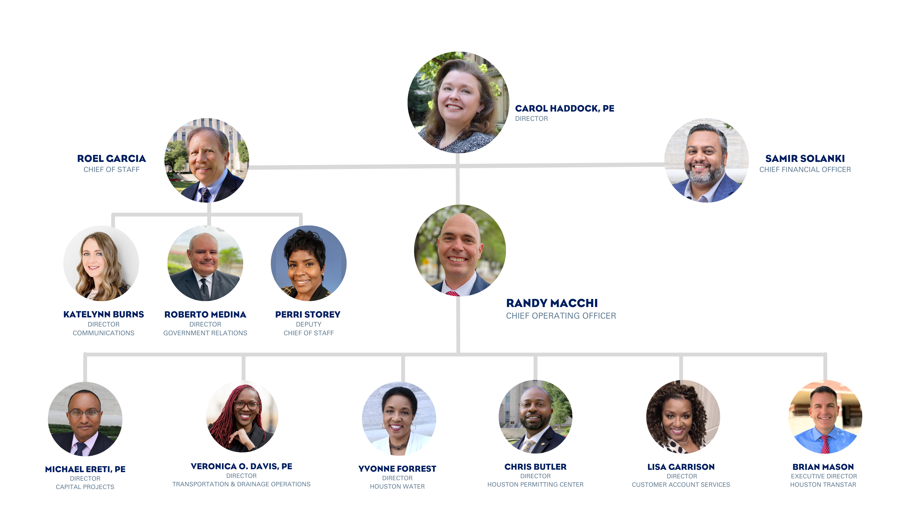
Executive TEAM

Slide 5
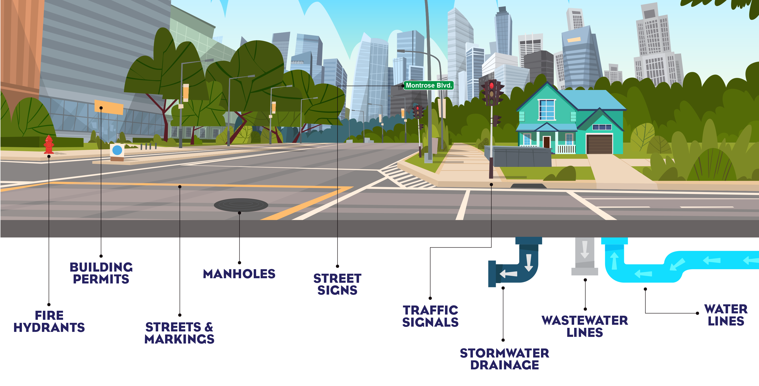
Public infrastructure

Slide 6
HOUSTON PUBLIC WORKS
16,000
3,900
163B
LANE MILES OF STREETS
MILES OF STORM DRAINS
GALLONS OF WATER TREATED PER YEAR
2,800
5.8M
2,450
MILES OF ROADSIDE DITCHES
WATERBILLS SENT PER YEAR
TRAFFIC SIGNALS
467
$2.4B
4,000
TYPES OF PERMITS
ANNUAL BUDGET
EMPLOYEES

Slide 7
Section Title
sample subhead text

Slide 8
Section Title
sample subhead text

Slide 9
Content Slide Sample
sample text
sample text
sample text
sample text
sample text
sample text
sample text
sample text

Slide 10
Content Slide Sample (Large Image)
This is an example of supporting information.

Slide 11
Content Slide Sample (Smart Object)
Sample
Sample
Sample
Sample
SUBTITLE SAMPLE
This is an example
of supporting information.

Slide 12
Content Slide Sample (Smart Object)
Sample Text
Sample Text
Sample Text
Sample Text
This is an example of supporting information.

Slide 13
Content Slide Sample (Table)
SAMPLE TEXT | SAMPLE TEXT | SAMPLE TEXT | SAMPLE TEXT | SAMPLE TEXT
First Sample | First Sample | First Sample | First Sample | First Sample
- | Second Sample | Second Sample | Second Sample | Second Sample
- | - | Third Sample | Third Sample | Third Sample
- | - | - | Fourth Sample | Fourth Sample
- | - | - | - | Fifth Sample
Total | Total | Total | Total | Total

Slide 14
Content Slide Sample (Columns)
SUBTITLE SAMPLE
SUBTITLE SAMPLE

Slide 15
Feature Slide Sample (Chart)
Feature Slide Subtitle Sample
25%
50%
75%
TEXT HERE
TEXT HERE
TEXT HERE
This is an example of supporting information.

Slide 16
Feature Slide Sample (Infographic)
Feature Slide Subtitle Sample
85%
60%
This is an example of supporting information.

Slide 17
Feature Slide Sample (Process)
Feature Slide Subtitle Sample
Sample 1
More information
Sample 2
More information
Sample 3
More information
This is an example of supporting information.

Slide 18
Text goes here

Slide 19
TEXT GOES HERE
SUB TEXT GOES HERE

Slide 20
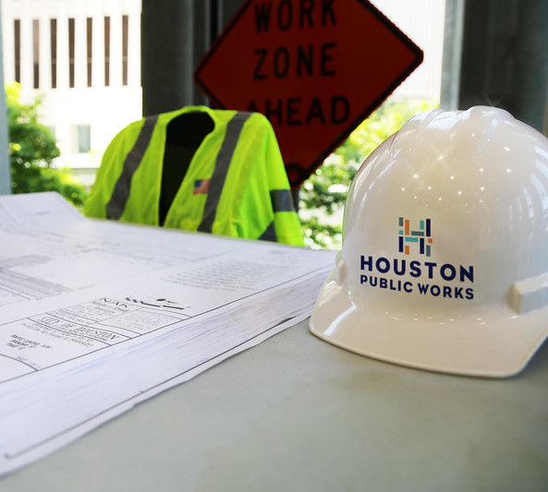
Text goes here
text goes here
more text
more text
more text

Slide 21
Text goes here
text goes here
more text
more text
more text

Slide 23
Text goes here
text goes here
more text
more text
more text

Slide 24
Sample of large text used for a break or for impact in a presentation

Slide 25
Sample of large text used for a break or for impact in a presentation

Slide 26
Sample of large text used for a break or for impact in a presentation

Slide 27
thank you!

Slide 28
icons
NEED AN ICON OR GRAPHIC?
COMMUNICATIONS@HOUSTONTX.GOV

